Slide 1
Design Patterns
Ina Fløysvik Pedersen
Notes:
Welcome to Fag Kaffe om Design Patterns.
I’m Ina Fløysvik Pedersen

Slide 2
Backround
Design Patterns: Elements of Reusable Object-Oriented software (1994)
Erich Gamma, John Vlissides, Ralph Johnson, and Richard Helm (Gang of Four)
23 Design Patterns
New patterns
Notes:
All the way back in 1994, Erich, John, Ralph and Richard also known as the Gang of Four. Created a book called Design Patterns: Elements of Reusable Object-Orented software.
The book looks into and give examples to all 23 design patterns, and explain use cases for the pattern, as well as consequences.
It has appeared newer patterns making the total of design patterns I found to 29 design patterns. I will mention more about these later.

Slide 3
What is a Design Pattern & why use it?
A general, reusable solution
A template
Creating flexible, easily maintainable applications
Sometimes you don’t notice
Follow the intent of the pattern
Notes:
A design Pattern is a general, reusable solution to a commonly occurring problem within a given context in software design.
You can look at the design patterns as a template that you could use to solve common issues that you encounter in software design.
Many of the design patterns are built-in to example Visual Studio libraries, so you do not notice that you are using them.
As long as you follow the patterns intent, you can implement the pattern in various ways.
You use Design Patterns to: Accelerate the development process, gives code readability, making your code more reusable and efficient. Creating a flexible and easily maintainable code.

Slide 4
Categories
Creational
Abstract Factory
Builder
Factory Method
Prototype
Singleton
Structural
Adapter
Bridge
Composite
Decorator
Facade
Flyweight
Proxy
Behavioral
Chain of Responsibility
Command
Interpreter
Iterator
Mediator
Memento
Observer
State
Strategy
Template Method
Visitor
Notes:
Design Patterns are separated into three categories, Creational, Structural, and Behavioral.
Creational patterns deals with object creations. The idea behind these patterns is to abstract the object instantiation process and make your system independent of how its objects are created, composed, and represented.
It consist of 5 patterns. Abstract Factory, Builder, Factory Method, Prototype and Singleton.
Structural patterns deals with ways to define relations between classes and objects. This pattern is concerned with how classes and objects are composed to form larger structures.
It consist of 7 patterns, Adapter, Bridge, Composite, Decorator, Facade, Flyweight and Proxy.
Behavioral patterns defines ways to communicate between classes or objects. They characterize complex control flow that is difficult to follow at runtime and then let you concentrate on the way objects are interconnected.
It consist of 11 patterns, Chain of Responsibility, Command, Interpreter, Iterator, Mediator, Memento, Observer, State, Strategy, Template Method and Visitor

Slide 5
New Patterns
Null Object Pattern
Specification Pattern
Rule Engine Pattern
Data Access Patterns
Repository Pattern
Unit of Work Pattern
Lazy Load Pattern
Notes:
Null object pattern, is when you use null object to avoid null checks. This simplifies our code, makes it easier to read and write, and decreases complexity. Returned object is not null, meaning when we ask for something, we can be sure that what we are getting back isn't null.
Specification pattern helps gather domain knowledge in a single place and then reuse it to perform database lookups, in memory validation, and creation of new objects. Specification pattern is a part of Domain-Driven Design.

Slide 6
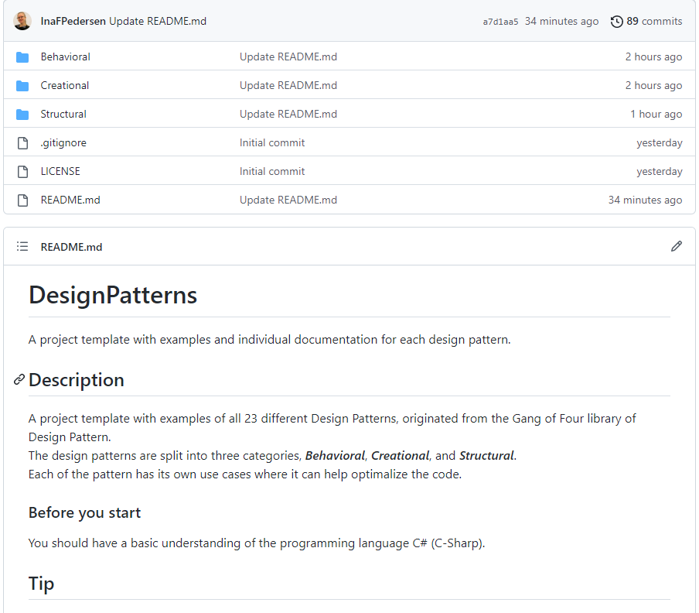
Examples of design Patterns!
Design Patterns: https://app.pluralsight.com/library/courses/c-sharp-10-design-patterns/table-of-contents
Git Repository: https://github.com/InaFPedersen/DesignPatterns
Description
Use cases
Consequences
Related patterns
Null Object: https://app.pluralsight.com/library/courses/csharp-design-patterns-null-object/table-of-contents
Specification Pattern: https://app.pluralsight.com/library/courses/csharp-specification-pattern/table-of-contents
Data Access Patterns: https://app.pluralsight.com/library/courses/c-sharp-design-patterns-data-access-patterns/table-of-contents
Rule Engine Patterns: https://app.pluralsight.com/library/courses/c-sharp-design-patterns-rules-pattern/table-of-contents
Notes:
I have created a Git Repository that I will share with you!
The repository content is based on the Pluralsight course in Design patterns by Kevin Dockx. That I can really recommend
Here I have given examples of each pattern.
That contains an individual pattern ReadMe file that gives individual information about:
description, examples of cases where it is beneficial to use the pattern, what the consequences of using the pattern are. And which patterns relate to each other.

Slide 7

Favorite
Favorite design patterns
Mediator
Builder
Bridge
But most of the 23 design patterns are amazing!
Which are your favorite pattern?
Notes:
Throughout the course I made a list of my favorite design patterns, that I have used in some degree before but not always correctly.
The Behavioral pattern, Mediator, is an efficient pattern to use when you have a lot of communication between objects.
The mediator will be put in the middle and the objects are forced to communicate via the mediator.
This promotes loose coupling by keeping objects from referring to each other explicitly, and it lets you vary their interactions.
The Creational Pattern Builder, is really good to use when you are dealing with object creation.
It let’s you construct complex objects step by step, and by doing so, the same construction process can create different representations.
The Structural pattern Bridge, is a commonly used pattern, and it can decouple an abstraction from its implementation so the two can vary independently.
Which means you can develop and make changes independently. The abstractions handle complexity by hiding the parts we don’t need to know about.

Slide 8


Questions?

